Slide 1




Not All Claims are Created Equal: Choosing the Right Statistical Approach to Assess Hypotheses
Erfan Sadeqi-Azer Daniel Khashabi Ashish Sabharwal Dan Roth
Indiana University (now at Google) Allen Institute for AI Allen Institute for AI Univ. of Pennsylvania

Slide 2
This work

Slide 3
This work
Q: What is this work about?
Q: What do you mean by “hypothesis”?
Q: Why should I care about hypothesis assessment?

Slide 4
This work
Q: What is this work about?
Q: What do you mean by “hypothesis”?
Q: Why should I care about hypothesis assessment?
Different hypothesis assessment algorithms and their comparison

Slide 5
This work
Q: What is this work about?
Q: What do you mean by “hypothesis”?
Q: Why should I care about hypothesis assessment?
Different hypothesis assessment algorithms and their comparison

Slide 6
This work
Q: What is this work about?
Q: What do you mean by “hypothesis”?
Q: Why should I care about hypothesis assessment?
Different hypothesis assessment algorithms and their comparison
it’s a prediction, based on certain assumptions & observations e.g., classifier-1 is inherently better than classifier-2

Slide 7
This work
Q: What is this work about?
Q: What do you mean by “hypothesis”?
Q: Why should I care about hypothesis assessment?
Different hypothesis assessment algorithms and their comparison
it’s a prediction, based on certain assumptions & observations e.g., classifier-1 is inherently better than classifier-2

Slide 8
This work
Q: What is this work about?
Q: What do you mean by “hypothesis”?
Q: Why should I care about hypothesis assessment?
Different hypothesis assessment algorithms and their comparison
it’s a prediction, based on certain assumptions & observations e.g., classifier-1 is inherently better than classifier-2
Like any empirical field, in NLP we need to follow scientific principles
for drawing conclusions.

Slide 9
Statistical tools considered in this work
p-value
Bayes Factor
Confidence Interval
Posterior Interval

Slide 10
Contributions

Slide 11
Contributions
Quantify usage trends in NLP community:
Annotated ACL’18 papers (~440 papers)
Surveyed ~50 random NLP practitioners
Findings:
Lack of awareness about various algorithms.
Poor interpretation of statistical tools – especially the popular ones.
Misleading reporting, resulting in unintended conclusions.
A Python package for Bayesian statistical hypothesis assessment

Slide 12
Contributions
Quantify usage trends in NLP community:
Annotated ACL’18 papers (~440 papers)
Surveyed ~50 random NLP practitioners
Findings:
Lack of awareness about various algorithms.
Poor interpretation of statistical tools – especially the popular ones.
Misleading reporting, resulting in unintended conclusions.
A Python package for Bayesian statistical hypothesis assessment

Slide 13
Contributions
Quantify usage trends in NLP community:
Annotated ACL’18 papers (~440 papers)
Surveyed ~50 random NLP practitioners
Findings:
Lack of awareness about various algorithms.
Poor interpretation of statistical tools – especially the popular ones.
Misleading reporting, resulting in unintended conclusions.
A Python package for Bayesian statistical hypothesis assessment

Slide 14
Contributions
Quantify usage trends in NLP community:
Annotated ACL’18 papers (~440 papers)
Surveyed ~50 random NLP practitioners
Findings:
Lack of awareness about various algorithms.
Poor interpretation of statistical tools – especially the popular ones.
Misleading reporting, resulting in unintended conclusions.
A Python package for Bayesian statistical hypothesis assessment

Slide 15
Contributions
Quantify usage trends in NLP community:
Annotated ACL’18 papers (~440 papers)
Surveyed ~50 random NLP practitioners
Findings:
Lack of awareness about various algorithms.
Poor interpretation of statistical tools – especially the popular ones.
Misleading reporting, resulting in unintended conclusions.
A Python package for Bayesian statistical hypothesis assessment

Slide 16
Contributions
Quantify usage trends in NLP community:
Annotated ACL’18 papers (~440 papers)
Surveyed ~50 random NLP practitioners
Findings:
Lack of awareness about various algorithms.
Poor interpretation of statistical tools – especially the popular ones.
Misleading reporting, resulting in unintended conclusions.
A Python package for Bayesian statistical hypothesis assessment

Slide 17
Contributions
Quantify usage trends in NLP community:
Annotated ACL’18 papers (~440 papers)
Surveyed ~50 random NLP practitioners
Findings:
Lack of awareness about various algorithms.
Poor interpretation of statistical tools – especially the popular ones.
Misleading reporting, resulting in unintended conclusions.
A Python package for Bayesian statistical hypothesis assessment

Slide 18
Contributions
Quantify usage trends in NLP community:
Annotated ACL’18 papers (~440 papers)
Surveyed ~50 random NLP practitioners
Findings:
Lack of awareness about various algorithms.
Poor interpretation of statistical tools – especially the popular ones.
Misleading reporting, resulting in unintended conclusions.
A Python package for Bayesian statistical hypothesis assessment
https://github.com/allenai/HyBayes

Slide 19
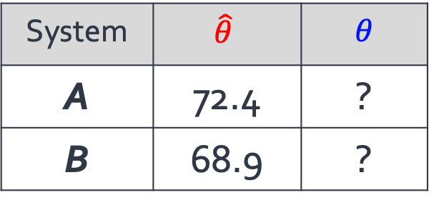
A Typical AI Experiment
System | $$\hat{θ}$$ | $θ$
A | 72.4 | ?
B | 68.9 | ?
(Clark et al., 2018)
|D|= 2376

Slide 20
A Typical AI Experiment
Empirical performance
System | $$\hat{θ}$$ | $θ$
A | 72.4 | ?
B | 68.9 | ?
(Clark et al., 2018)
|D|= 2376

Slide 21
A Typical AI Experiment
Empirical performance
Inherent performance
System | $$\hat{θ}$$ | $θ$
A | 72.4 | ?
B | 68.9 | ?
(Clark et al., 2018)
|D|= 2376

Slide 22
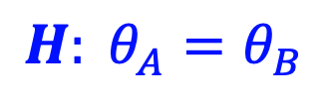
A Typical AI Experiment
The apparent difference in empirical performances be explained simply by random chance.
We have sufficient evidence to conclude that A is in fact inherently stronger than B.
$$H: θ_{A}=θ_{B}$$
Empirical performance
Inherent performance
System | $$\hat{θ}$$ | $θ$
A | 72.4 | ?
B | 68.9 | ?
(Clark et al., 2018)
|D|= 2376

Slide 23
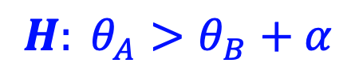
A Typical AI Experiment
The apparent difference in empirical performances be explained simply by random chance.
We have sufficient evidence to conclude that A is in fact inherently stronger than B.
$$H: θ_{A}=θ_{B}$$
Empirical performance
Inherent performance
System | $$\hat{θ}$$ | $θ$
A | 72.4 | ?
B | 68.9 | ?
$$H: θ_{A}>θ_{B}+α$$
(Clark et al., 2018)
|D|= 2376

Slide 24
A Typical AI Experiment
The apparent difference in empirical performances be explained simply by random chance.
We have sufficient evidence to conclude that A is in fact inherently stronger than B.
$$H: θ_{A}=θ_{B}$$
Empirical performance
Inherent performance
System | $$\hat{θ}$$ | $θ$
A | 72.4 | ?
B | 68.9 | ?
$$H: θ_{A}>θ_{B}+α$$
(Clark et al., 2018)
|D|= 2376

Slide 25
Statistical tools: big picture
p-value
Bayes Factor
Confidence Interval
Posterior Intervals

Slide 26
Statistical tools: big picture
p-value
Bayes Factor
Confidence Interval
Posterior Intervals

Slide 27
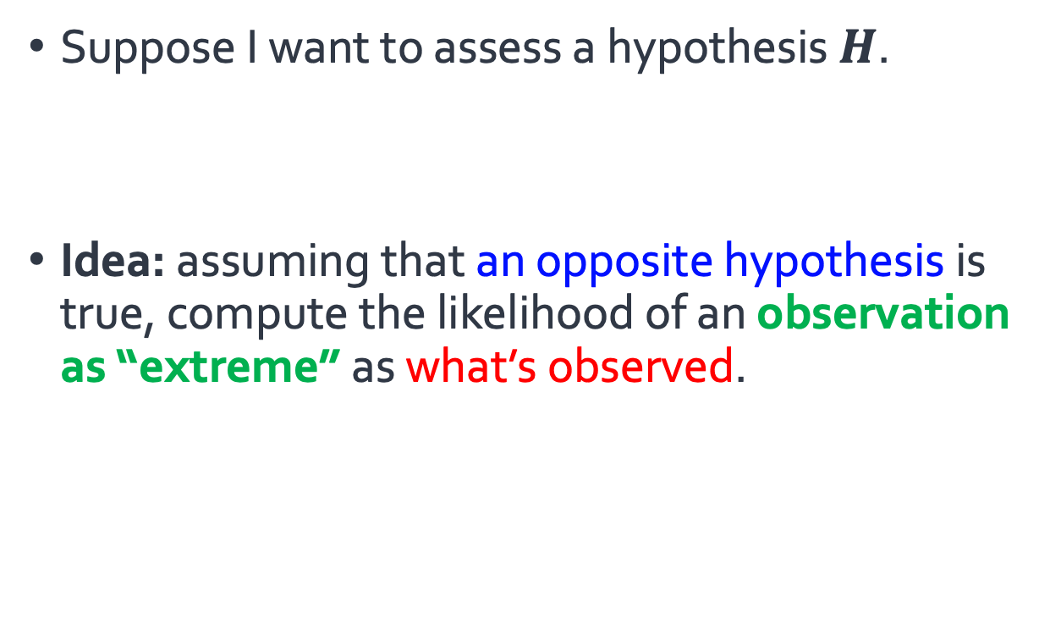
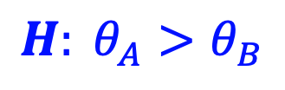
Statistical tools: big picture
Suppose I want to assess a hypothesis $H$.
Idea: assuming that an opposite hypothesis is true, compute the likelihood of an observation as “extreme” as what’s observed.
$$H: θ_{A}>θ_{B}$$
p-value
Bayes Factor
Confidence Interval
Posterior Intervals

Slide 28
Statistical tools: big picture
Suppose I want to assess a hypothesis $H$.
Idea: assuming that an opposite hypothesis is true, compute the likelihood of an observation as “extreme” as what’s observed.
$$H: θ_{A}>θ_{B}$$
p-value
Bayes Factor
Confidence Interval
Posterior Intervals

Slide 29
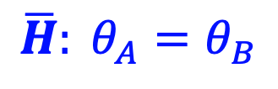
Statistical tools: big picture
Suppose I want to assess a hypothesis $H$.
Idea: assuming that an opposite hypothesis is true, compute the likelihood of an observation as “extreme” as what’s observed.
$$H: θ_{A}>θ_{B}$$
$$\overline{H}: θ_{A}=θ_{B}$$
p-value
Bayes Factor
Confidence Interval
Posterior Intervals

Slide 30
Statistical tools: big picture
Suppose I want to assess a hypothesis $H$.
Idea: assuming that an opposite hypothesis is true, compute the likelihood of an observation as “extreme” as what’s observed.
$$H: θ_{A}>θ_{B}$$
$$\overline{H}: θ_{A}=θ_{B}$$
p-value
Bayes Factor
Confidence Interval
Posterior Intervals
the accuracy gap between the two systems

Slide 31
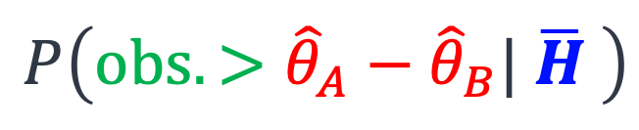
Statistical tools: big picture
Suppose I want to assess a hypothesis $H$.
Idea: assuming that an opposite hypothesis is true, compute the likelihood of an observation as “extreme” as what’s observed.
$$H: θ_{A}>θ_{B}$$
$$\overline{H}: θ_{A}=θ_{B}$$
p-value
Bayes Factor
Confidence Interval
Posterior Intervals
the accuracy gap between the two systems
$$P\left(obs. >{\hat{θ}}_{A}−{\hat{θ}}_{B}| \overline{H} \right)$$

Slide 32
Statistical tools: big picture
Suppose I want to assess a hypothesis $H$.
Idea: assuming that an opposite hypothesis is true, compute the likelihood of an observation as “extreme” as what’s observed.
$$H: θ_{A}>θ_{B}$$
$$\overline{H}: θ_{A}=θ_{B}$$
p-value
Bayes Factor
Confidence Interval
Posterior Intervals
the accuracy gap between the two systems
$$P\left(obs. >{\hat{θ}}_{A}−{\hat{θ}}_{B}| \overline{H} \right)$$
p-value

Slide 33
Statistical tools: big picture
p-value
Bayes Factor
Confidence Interval
Posterior Intervals

Slide 34
Statistical tools: big picture
p-value
Bayes Factor
Confidence Interval
Posterior Intervals

Slide 35
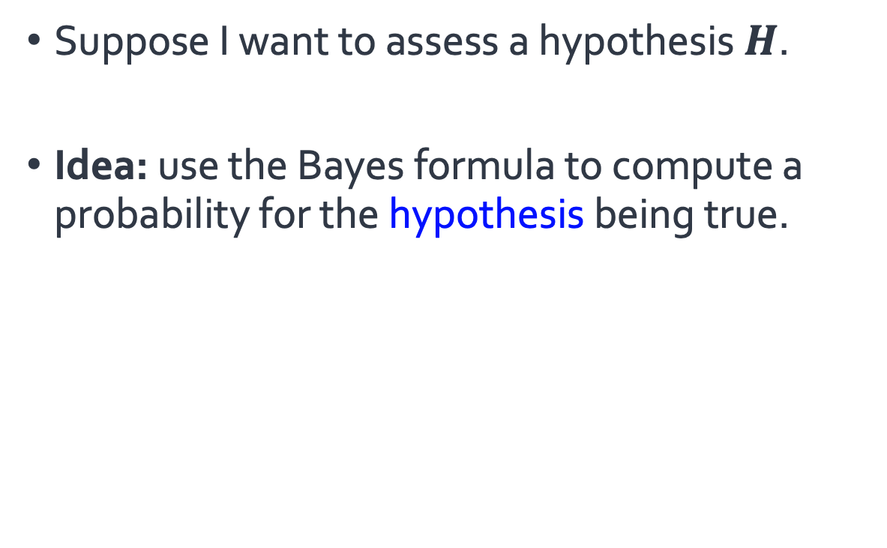
Statistical tools: big picture
Suppose I want to assess a hypothesis $H$.
Idea: use the Bayes formula to compute a probability for the hypothesis being true.
p-value
Bayes Factor
Confidence Interval
Posterior Intervals

Slide 36
Statistical tools: big picture
Suppose I want to assess a hypothesis $H$.
Idea: use the Bayes formula to compute a probability for the hypothesis being true.
p-value
Bayes Factor
Confidence Interval
Posterior Intervals

Slide 37
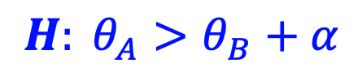
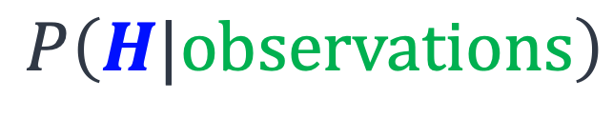
Statistical tools: big picture
Suppose I want to assess a hypothesis $H$.
Idea: use the Bayes formula to compute a probability for the hypothesis being true.
p-value
Bayes Factor
$$H: θ_{A}>θ_{B}+α$$
Confidence Interval
Posterior Intervals
$$P\left(H|observations\right)$$

Slide 38
Statistical tools: big picture
Suppose I want to assess a hypothesis $H$.
Idea: use the Bayes formula to compute a probability for the hypothesis being true.
Bayesian
p-value
Bayes Factor
$$H: θ_{A}>θ_{B}+α$$
Confidence Interval
Posterior Intervals
$$P\left(H|observations\right)$$

Slide 39
Statistical tools: big picture
Suppose I want to assess a hypothesis $H$.
Idea: use the Bayes formula to compute a probability for the hypothesis being true.
Frequentist
Bayesian
p-value
Bayes Factor
$$H: θ_{A}>θ_{B}+α$$
Confidence Interval
Posterior Intervals
$$P\left(H|observations\right)$$

Slide 40
Ease of Interpretation
Usage Patterns

Slide 41
Ease of Interpretation
Usage Patterns

Slide 42
Trends and Patterns in the field
Study NLP conference papers: ACL’18 papers (439 papers)
How many papers did use significance testing?
p-value
Bayes Factor
Confidence Interval
Posterior Intervals

Slide 43
Trends and Patterns in the field
Study NLP conference papers: ACL’18 papers (439 papers)
How many papers did use significance testing?
73
p-value
Bayes Factor
Confidence Interval
Posterior Intervals

Slide 44
Trends and Patterns in the field
Study NLP conference papers: ACL’18 papers (439 papers)
How many papers did use significance testing?
73
p-value
Bayes Factor
Confidence Interval
Posterior Intervals
6

Slide 45
Trends and Patterns in the field
Study NLP conference papers: ACL’18 papers (439 papers)
How many papers did use significance testing?
73
0
p-value
Bayes Factor
Confidence Interval
Posterior Intervals
6

Slide 46
Trends and Patterns in the field
Study NLP conference papers: ACL’18 papers (439 papers)
How many papers did use significance testing?
73
0
p-value
Bayes Factor
Confidence Interval
Posterior Intervals
6
0

Slide 47
Trends and Patterns in the field
Study NLP conference papers: ACL’18 papers (439 papers)
How many papers did use significance testing?
73
0
Many papers (~360) did not include any hypothesis assessment.
p-value based tests are the dominant choice among NLP practitioners.
p-value
Bayes Factor
Confidence Interval
Posterior Intervals
6
0

Slide 48
Trends and Patterns in the field
Study NLP conference papers: ACL’18 papers (439 papers)
How many papers did use significance testing?
73
0
Many papers (~360) did not include any hypothesis assessment.
p-value based tests are the dominant choice among NLP practitioners.
p-value
Bayes Factor
Confidence Interval
Posterior Intervals
6
0

Slide 49
Trends and Patterns in the field
Study NLP conference papers: ACL’18 papers (439 papers)
How many papers did use significance testing?
73
0
Many papers (~360) did not include any hypothesis assessment.
p-value based tests are the dominant choice among NLP practitioners.
p-value
Bayes Factor
Confidence Interval
Posterior Intervals
6
0
Why?

Slide 50
Lack of exposure to alternative algorithms

Slide 51
Lack of exposure to alternative algorithms
The imbalance in usage:
Is it intentional?
Many people did not know the definition of “Bayes Factor.” 🤔

Slide 52
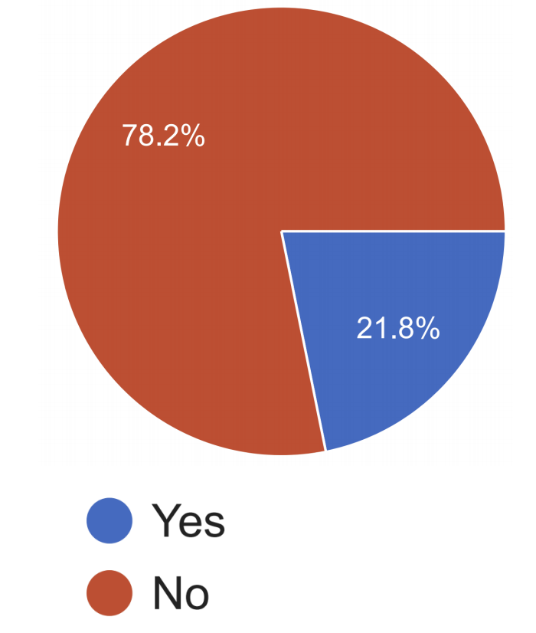
Lack of exposure to alternative algorithms
The imbalance in usage:
Is it intentional?
Many people did not know the definition of “Bayes Factor.” 🤔
Do you know the definition of "Bayes Factor"?

Slide 53
Lack of exposure to alternative algorithms
The imbalance in usage:
Is it intentional?
Many people did not know the definition of “Bayes Factor.” 🤔
Do you know the definition of "Bayes Factor"?

Slide 54
Lack of exposure to alternative algorithms
The imbalance in usage:
Is it intentional?
Many people did not know the definition of “Bayes Factor.” 🤔
Do you know the definition of "Bayes Factor"?
We don’t teach the alternatives in our AI curriculum.

Slide 55
Ease of Interpretation
Usage Patterns

Slide 56
NLP community is over-using certain techniques.
One reason could be researchers’ lack of exposure to the alternatives.
Ease of Interpretation
Usage Patterns

Slide 57
Ease of Interpretation
Usage Patterns

Slide 58
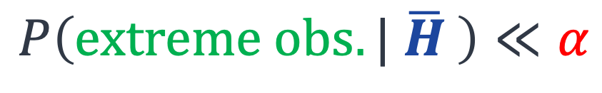
Are we good at interpreting the p-values?
$$P\left(extreme obs.| \overline{H} \right)≪α$$
p-value

Slide 59
Are we good at interpreting the p-values?
$$P\left(extreme obs.| \overline{H} \right)≪α$$
p-value
Pretty complex notion!

Slide 60
Are we good at interpreting the p-values?
$$P\left(extreme obs.| \overline{H} \right)≪α$$
p-value
“The probability of obtaining test results at least as extreme as the results actually observed during the test, assuming that the null-hypothesis is correct.” --your favorite statistics textbook
Pretty complex notion!

Slide 61
A Survey Question: Interpreting P-value (1)

Slide 62
A Survey Question: Interpreting P-value (1)
Question 1: do you know p-values and its interpretation?

Slide 63
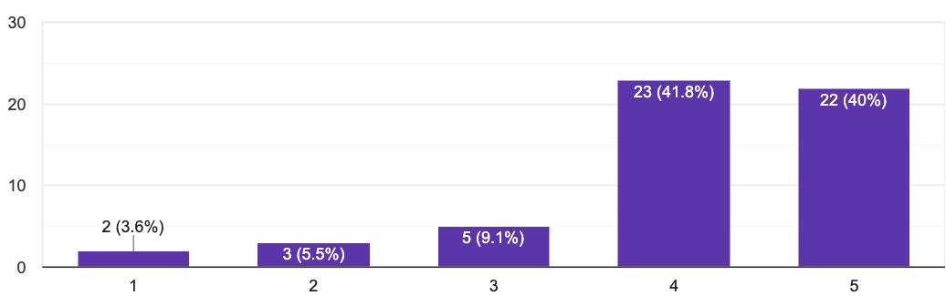
A Survey Question: Interpreting P-value (1)
Question 1: do you know p-values and its interpretation?

Slide 64
A Survey Question: Interpreting P-value (1)
Question 1: do you know p-values and its interpretation?
86% expressed fair-to-complete confidence in their ability to interpret p-values.

Slide 65
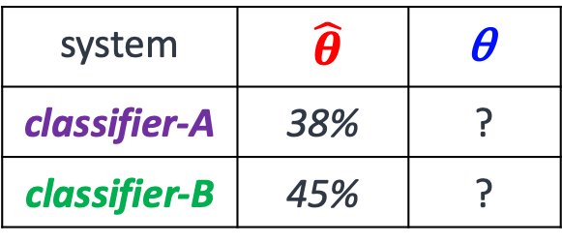
A Survey Question: Interpreting P-value (2)
system | $\hat{θ}$ | $$\text{θ}$$
classifier-A | 38% | ?
classifier-B | 45% | ?

Slide 66
A Survey Question: Interpreting P-value (2)
The authors claim that the improvement of B over A is “statistically significant” with a significance level of 0.01. Which of the followings is correct?
The probability of observing a margin 7% is at most 0.01, assuming that the two classifiers inherently have the same performance.
With a probability 99% classifier-2 will have a higher performance than classifier-1.
…
system | $\hat{θ}$ | $$\text{θ}$$
classifier-A | 38% | ?
classifier-B | 45% | ?

Slide 67
A Survey Question: Interpreting P-value (2)
The authors claim that the improvement of B over A is “statistically significant” with a significance level of 0.01. Which of the followings is correct?
The probability of observing a margin 7% is at most 0.01, assuming that the two classifiers inherently have the same performance.
With a probability 99% classifier-2 will have a higher performance than classifier-1.
…
system | $\hat{θ}$ | $$\text{θ}$$
classifier-A | 38% | ?
classifier-B | 45% | ?

Slide 68
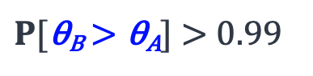
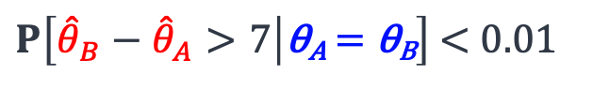
A Survey Question: Interpreting P-value (2)
The authors claim that the improvement of B over A is “statistically significant” with a significance level of 0.01. Which of the followings is correct?
The probability of observing a margin 7% is at most 0.01, assuming that the two classifiers inherently have the same performance.
With a probability 99% classifier-2 will have a higher performance than classifier-1.
…
system | $\hat{θ}$ | $$\text{θ}$$
classifier-A | 38% | ?
classifier-B | 45% | ?
$P\left[{\hat{θ}}_{B}−{\hat{θ}}_{A}>7 | \text{θ}\text{A} \text{=} \text{θ}\text{B}\right]$ < 0.01
$P[\text{θ}\text{B}\text{ > }\text{θ}\text{A}]$ > 0.99

Slide 69
A Survey Question: Interpreting P-value (2)
The authors claim that the improvement of B over A is “statistically significant” with a significance level of 0.01. Which of the followings is correct?
The probability of observing a margin 7% is at most 0.01, assuming that the two classifiers inherently have the same performance.
With a probability 99% classifier-2 will have a higher performance than classifier-1.
…
system | $\hat{θ}$ | $$\text{θ}$$
classifier-A | 38% | ?
classifier-B | 45% | ?
23%
$P\left[{\hat{θ}}_{B}−{\hat{θ}}_{A}>7 | \text{θ}\text{A} \text{=} \text{θ}\text{B}\right]$ < 0.01
30%
$P[\text{θ}\text{B}\text{ > }\text{θ}\text{A}]$ > 0.99
🤦
Only a small percentage correctly answered a basic p-value interpretation question.

Slide 70
Ease of interpretation: Bayesians vs Freq.
Frequentist
Bayesian
p-value
Bayes Factor
Confidence Interval
Posterior Intervals

Slide 71
Ease of interpretation: Bayesians vs Freq.
Frequentist
Bayesian
p-value
Bayes Factor
Confidence Interval
Posterior Intervals
Our participants mistakenly interpret frequentist notions in a Bayesian way.

Slide 72
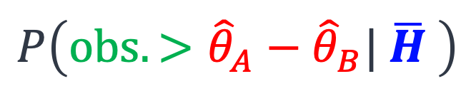
Ease of interpretation: Bayesians vs Freq.
Frequentist
Bayesian
p-value
Bayes Factor
$$P\left(obs. >{\hat{θ}}_{A}−{\hat{θ}}_{B}| \overline{H} \right)$$
p-value
Confidence Interval
Posterior Intervals
Our participants mistakenly interpret frequentist notions in a Bayesian way.

Slide 73

Ease of interpretation: Bayesians vs Freq.
Frequentist
Bayesian
p-value
Bayes Factor
$$P\left(obs. >{\hat{θ}}_{A}−{\hat{θ}}_{B}| \overline{H} \right)$$
$$P\left(H|observations\right)$$
p-value
Confidence Interval
Posterior Intervals
Our participants mistakenly interpret frequentist notions in a Bayesian way.

Slide 74
Ease of Interpretation
Usage Patterns
While p-valued based tests are the most popular choice among NLP practitioners, they’re difficult to understand and highly prone to misunderstanding.
Bayesian Intervals provide results that are more natural to interpret.

Slide 75
Summary

Slide 76
Summary
The work surveys four different alternatives for hypothesis assessment.
Details in the paper
We provide comparisons among these algorithms:
Whether their easy to interpret / misinterpret
…
We compare usage patterns:
Surveying the field
Manual annotation of papers
HyBayes: https://github.com/allenai/HyBayes

Slide 77
Summary
The work surveys four different alternatives for hypothesis assessment.
Details in the paper
We provide comparisons among these algorithms:
Whether their easy to interpret / misinterpret
…
We compare usage patterns:
Surveying the field
Manual annotation of papers
HyBayes: https://github.com/allenai/HyBayes

Slide 78
Summary
The work surveys four different alternatives for hypothesis assessment.
Details in the paper
We provide comparisons among these algorithms:
Whether their easy to interpret / misinterpret
…
We compare usage patterns:
Surveying the field
Manual annotation of papers
HyBayes: https://github.com/allenai/HyBayes

Slide 79
Summary
The work surveys four different alternatives for hypothesis assessment.
Details in the paper
We provide comparisons among these algorithms:
Whether their easy to interpret / misinterpret
…
We compare usage patterns:
Surveying the field
Manual annotation of papers
HyBayes: https://github.com/allenai/HyBayes

Slide 80
Summary
The work surveys four different alternatives for hypothesis assessment.
Details in the paper
We provide comparisons among these algorithms:
Whether their easy to interpret / misinterpret
…
We compare usage patterns:
Surveying the field
Manual annotation of papers
HyBayes: https://github.com/allenai/HyBayes

Slide 81
Summary
The work surveys four different alternatives for hypothesis assessment.
Details in the paper
We provide comparisons among these algorithms:
Whether their easy to interpret / misinterpret
…
We compare usage patterns:
Surveying the field
Manual annotation of papers
HyBayes: https://github.com/allenai/HyBayes

Slide 82
Summary
The work surveys four different alternatives for hypothesis assessment.
Details in the paper
We provide comparisons among these algorithms:
Whether their easy to interpret / misinterpret
…
We compare usage patterns:
Surveying the field
Manual annotation of papers
HyBayes: https://github.com/allenai/HyBayes

Slide 83
Summary
The work surveys four different alternatives for hypothesis assessment.
Details in the paper
We provide comparisons among these algorithms:
Whether their easy to interpret / misinterpret
…
We compare usage patterns:
Surveying the field
Manual annotation of papers
HyBayes: https://github.com/allenai/HyBayes

Slide 84
Summary
The work surveys four different alternatives for hypothesis assessment.
Details in the paper
We provide comparisons among these algorithms:
Whether their easy to interpret / misinterpret
…
We compare usage patterns:
Surveying the field
Manual annotation of papers
HyBayes: https://github.com/allenai/HyBayes

